Slide 1


Slide 2
Why I hate CSS

Slide 3
Refresher
CSS stands for Cascading Stylesheets
Used to make your life miserable
And to make your sites look a bit better….
It Sucks…
Syntax:
property:value
Examples:
text-align: center;
color: maroon;
height: 100px;
width: 100%;

Slide 4
Why we use CSS:

Slide 5
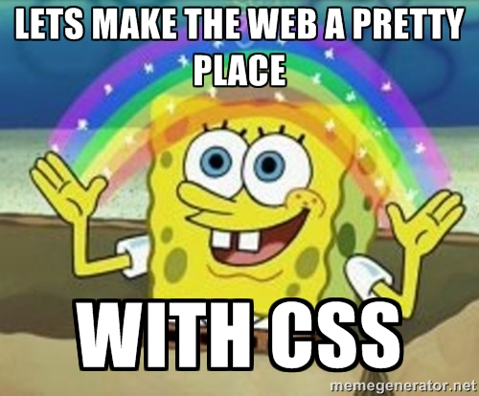

Slide 6
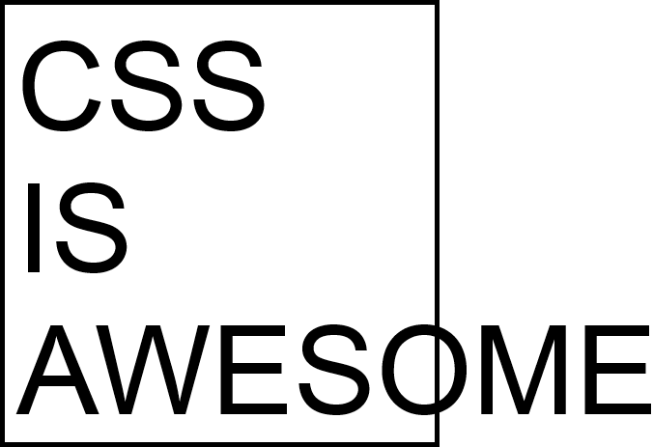
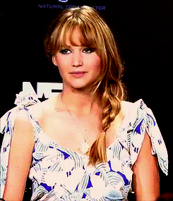
Notes:
Sorry, that’s a typo, it should be “not”. This is funny because the “Awesome” should be inside the box...

Slide 7
Inline Styles are BAD.
“JUST DON’T DO IT” - Shia Labeouf

Slide 8
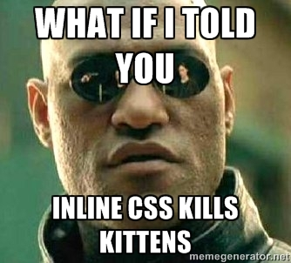
Notes:
HTML is used for the text and the layout. CSS is the styling. In programming, everything needs to be separated. Like the colored from the non-colored socks...

Slide 9
SELECTORS
Notes:
Fundamentals of CSS. Used to “target” specific elements. Can be classes, “id”’s etc. For example, if you only wanted to target an ID with “div1”, you’d be able to do so using the id selector.

Slide 10
ID’s
Can be created anywhere
Uses the “#” selector
Examples:
#[insert-id-here]
#hello-world
Id’s need to be unique

Slide 11
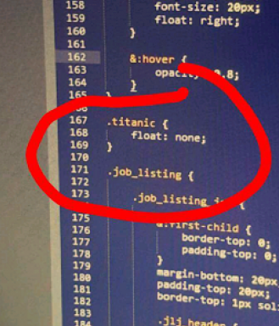
Classes
Can be created anywhere
Used on any element
Used to apply styles to multiple elements
Examples:
.[insert-class-name-here]
.sup-dude

Slide 12
External CSS Files
<html>
<head>
<title> *title goes here* </title>
<link href=”styles.css” type=”text/css” rel=”stylesheet”>
</head>
<body>
...
</body>
</html>

Slide 13
Your CSS File
//styles.css
.red {
color: red;
}
//index.html
<h1 class=”red”>Hi! I’m Red!</h1>

Slide 14
Let’s WRITE SOME CSS
Create 3 Div’s
Give each
a color
fixed height
if it doesn’t fit the entire width, make sure it is the full width of the container
Add a fourth div explaining your CSS experience
Hints:
To make something the full-width, you can use 100%
A fixed height just means a random height

Slide 15
What are these percentages?

Slide 16
Some more properties
float: left | right | none
color : #*insert hex here*

Slide 17

Challenge
Create a page with three columns!

Slide 18


That’s all I’ve Got...

Slide 19
Feedback
bit.ly/wdc-feedback

Slide 20
Attendance
http://bit.ly/1KZJsmM

